Slide 1

Evaluation on the thermal behavior of urban surfaces using an energy balance model
Fanxing Zeng, Naiping Gao
School of Mechanical Engineering, Tongji University

Slide 2
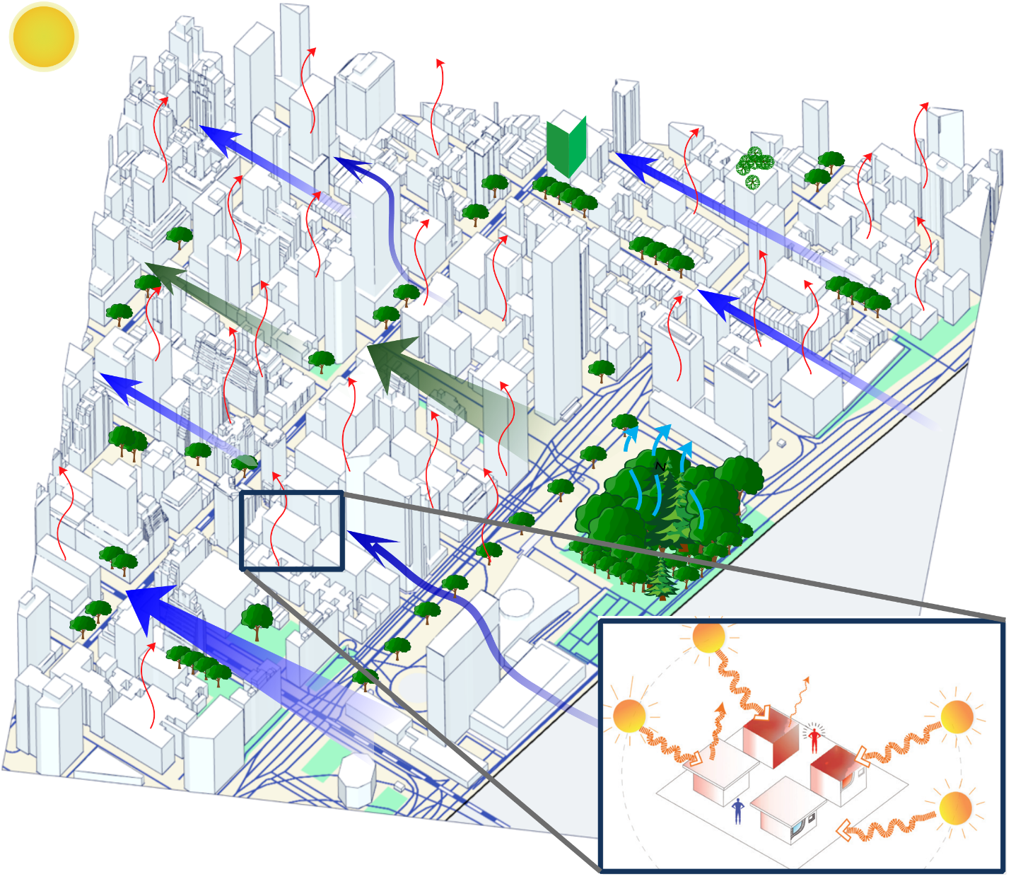
Outline
Motivation
Introduction
Town Energy Balance model (TEB)
Meteorological forcing data
Results
Annual temperature cycle
Diurnal temperature cycle
Conclusions

Slide 3
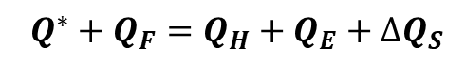
Motivation
Introduction
Results
Conclusions
What is the first step to understand
the nature of urban microclimate?
Micrometeorological model
Penman-Monteith equation
Computational Fluid Dynamic
（CFD）
Urban Canopy Model（UCM）
CFD & UCM
$$Q^{∗}+Q_{F}=Q_{H}+Q_{E}+∆Q_{S}$$
Urban surface temperature as a diagnostic parameter to describe the urban microclimate
Notes:
Before we go deep into the main topic, I want to talk about why we have chosen urban canopy mode to analyze thermal behaviors of urban area , or we say a lumped energy model model. So when I ask you :…? You may come out with different answers, and the answers will be very much depend on your research background and your research purposes? While in terms of the scales you are studying, if we use a tree as a scale indicator, the methods will all fall into the range of these three categories, namely ….. …… …… we found it very tricky to take into account both thermal and solar radiation into the model even in CFD, so in this stage, we used a energy balance model called teb to learn the urban surface temperature evoluation.

Slide 4
Motivation
Introduction
Results
Conclusions
TEB model
Meteorological forcing data
Town Energy Balance model (TEB)
An urban surface parameterization developed by Valéry Masson et al, Météo France
Purpose and design of TEB
Urban surface sensible and latent heat flux, momentum and radiation exchange for atmospheric models
TEB is not designed for
Simulations at the scale of one single building
Details of the wind and temperature fields in the street canyons (vs. CFD methods)
Details inside the buildings

Slide 5
Motivation
Introduction
Results
Conclusions
TEB model
Meteorological forcing data
Town Energy Balance model (TEB)
An urban surface parameterization developed by Valéry Masson et al, Météo France
Purpose and design of TEB
Urban surface sensible and latent heat flux, momentum and radiation exchange for atmospheric models
TEB is not designed for
Simulations at the scale of one single building
Details of the wind and temperature fields in the street canyons (vs. CFD methods)
Details inside the buildings

Slide 6
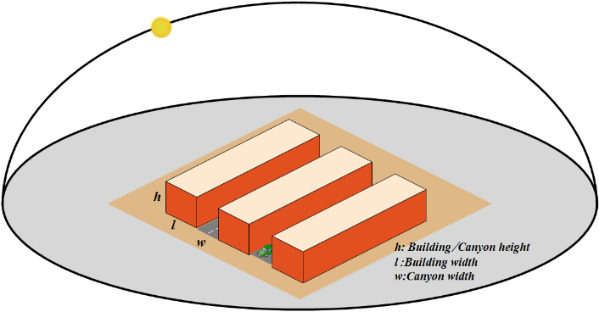
Motivation
Introduction
Results
Conclusions
TEB model
Meteorological forcing data
TEB assumptions on urban morphology
Buildings oriented along street canyons with
length >> width
Homogeneous urban morphology
Identical urban canyons
Any road orientation is possible and all exist with the same possibility
No discretization is performed on orientation

Slide 7
Motivation
Introduction
Results
Conclusions
TEB model
Meteorological forcing data
Radiation modification due to buildings
Solar zenith angle
Roof
Wall
（Masson 2000）
Road
Mean direct solar fluxes received in a canyon perpendicular to sun direction
Net longwave radiation is computed with one re-emission considered. The sky view factor for road and wall are needed.

Slide 8
Motivation
Introduction
Results
Conclusions
TEB model
Meteorological forcing data
Calculation of temperature, humidity and wind speed inside the street canyon
Where different surfaces (i.e. roof, wall and road) are normalized with the subscript to represent either R, r, or w.
Energy terms are net solar radiation, net infrared radiation, sensible heat flux, latent heat flux and conduction heat between the surface layer and the inner layer, respectively
Aerodynamic resistances Modified after Masson 2000

Slide 9
Motivation
Introduction
Results
Conclusions
TEB model
Meteorological forcing data
Required input data featuring the urban area
Surface cover fractions (building, road, vegetation)
Urban geometry
Building height
Wall to horizontal area ratio
Architectural characteristics
Albedo, emissivity, thickness, thermal conductivity
capacity of roofs, walls, road, floor and mass

Slide 10
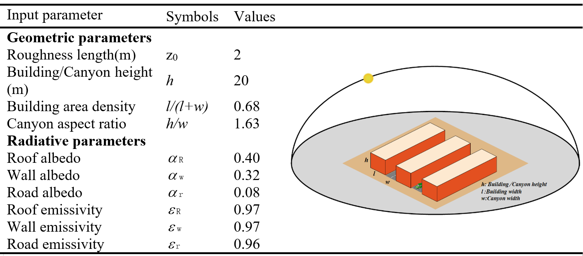
Motivation
Introduction
Results
Conclusions
TEB model
Meteorological forcing data
Inputs-urban geometry
Urban parameters input of TEB model for Toulouse city center

Slide 11
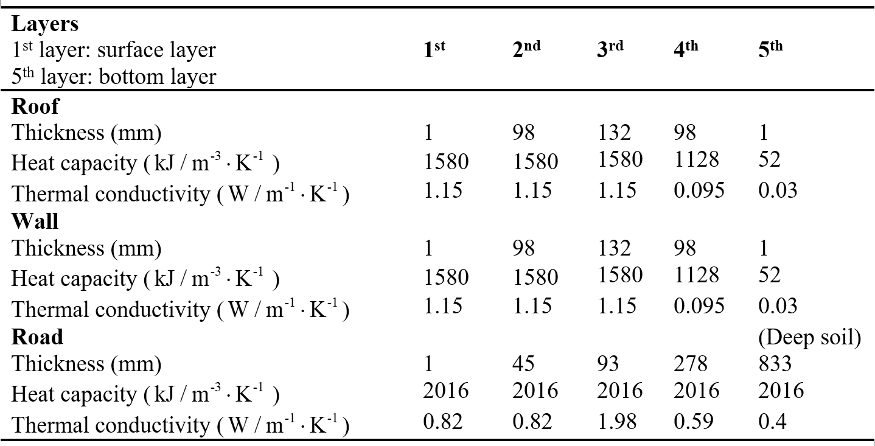
Motivation
Introduction
Results
Conclusions
TEB model
Meteorological forcing data
Inputs-thermal property
Surfaces discretization-5 layers

Slide 12
Motivation
Introduction
Results
Conclusions
TEB model
Meteorological forcing data
Required meteorological forcing data
Air temperature and specific humidity
Wind speed and direction
Direct and diffuse downwelling solar radiation
Downwelling infra-red radiation

Slide 13

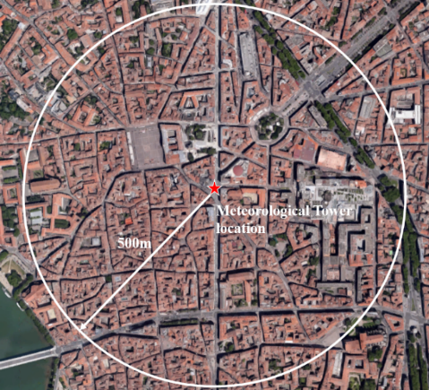
Motivation
Introduction
Results
Conclusions
TEB model
Meteorological forcing data
The CAPITOUL campaign
Canopy and Aerosol Particles Interaction in TOulouse Urban Layer
Observations in Toulouse, February 2004 to March 2005
Urban surface energy balance measured at meteorological mast
City center of Toulouse
Homogeneous urban morphology
~20m-high red brick buildings
Vegetation is rare
Not much industry

Slide 14
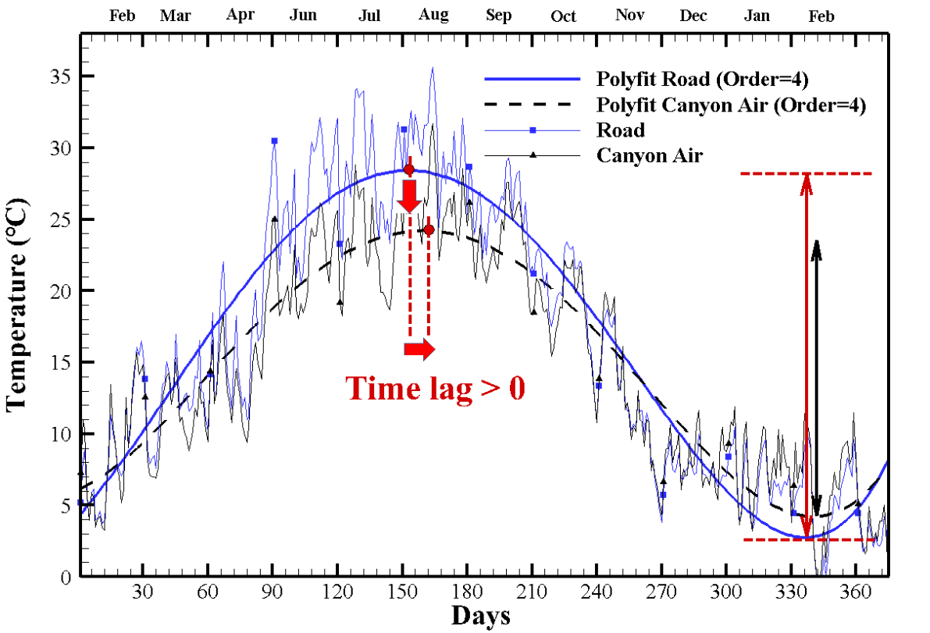
Motivation
Introduction
Results
Conclusions
Annual temperature cycle
20/02/2004-28/02/2005
TEB time step was fixed to 5min and outputs are averaged over 30min period.
Averaged road temperature
in the city center:
[2.8,28.4 ℃] Low value
Road vs. Canyon air temperature profile:
-Phase displacement
-Amplitude attenuation
The smooth curves derived from fourth order polynomial fit to the TEB mean temperatures

Slide 15
Motivation
Introduction
Results
Conclusions
Annual temperature cycle
Roof albedo:0.40
Road albedo: 0.08

Slide 16
Motivation
Introduction
Results
Conclusions
Annual temperature cycle

Slide 17
Motivation
Introduction
Results
Conclusions
Diurnal temperature cycle
Mar. 8 to Mar. 14, 2004
Jul. 25 to Jul. 31, 2004
Ensemble averaged weekly data
Oct. 15 to Oct. 21, 2004
Jan. 15 to Jan. 21, 2004

Slide 18
Motivation
Introduction
Results
Conclusions
Diurnal temperature validation
TEB evaluation:
One-month Measurement*
in Fall and winter with infra-red thermometers for a selected set of walls, roads and roofs with different orientations and aspect ratios.
All temperature
vary strongly
in summer
 | Fall (15/10/04-15/11/04) |  | Winter (15/01/04-15/02/04)
 | Bias (K) | RMSD (K) | Bias (K) | RMSD (K)
Roof | 1.0 | 2.1 | 1.2 | 2.2
Road | -1.4 | 1.6 | -2.2 | 2.4
Wall | 0.8 | 0.9 | 0.0 | 0.5
Ensemble-averaged diurnal temperature cycle for seven sunny days in different seasons
* Raw data from Pigeon 2008

Slide 19
Motivation
Introduction
Results
Conclusions
Conclusions
Annual mean temperature cycle of urban surfaces and canyon air indicate a time lag phenomenon between air and canyon surfaces.
The surface temperature varies strongly(24℃ for roof) in a daily cycle during summer time but an even larger variation could be discovered if we enlarge the evaluation period to an annual cycle(26℃ for road).
In the comparison of the diurnal and annual cycle, the temporal and spatial scale is found to be the cause of different temperature evolution pattern for urban surfaces.

Slide 20
Motivation
Introduction
Results
Conclusions
Further discussion
TEB model is a useful tool to reveal the thermal response of urban canyon surfaces if the forcing data is accessible.
However, it’s hard to validate the simulation results -classical techniques can only be applied on a limited extent (e.g. only few observational sites in the city, shorter time series)
Achilles’ heel of impact studies using TEB: garbage in garbage out?

Slide 21
Thank you
solarzeng@hotmail.com

